Slide 1



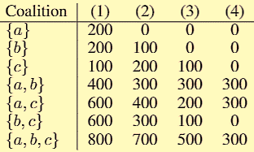
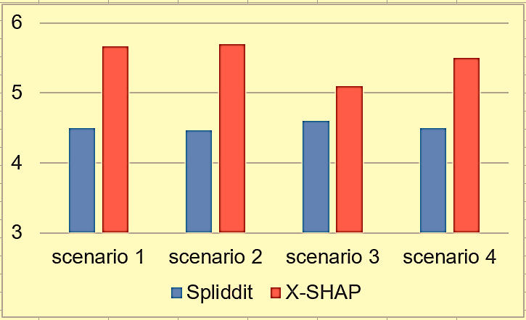

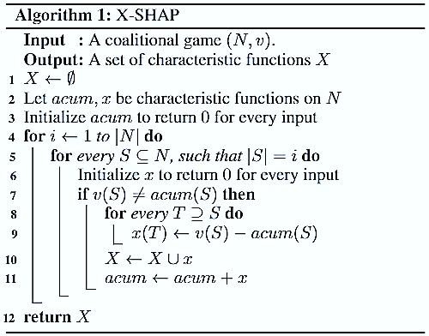
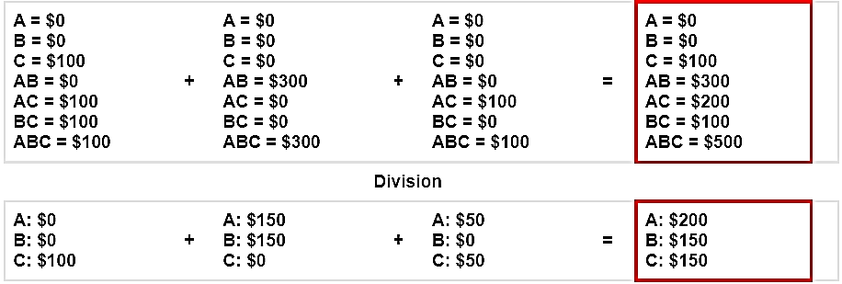

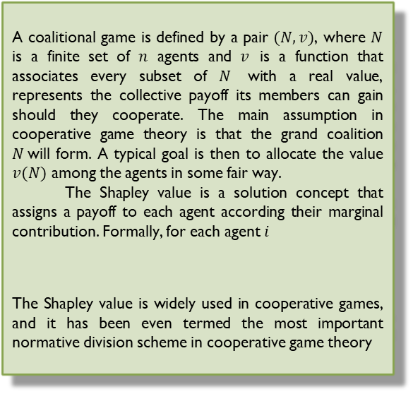


Explainable Fair Revenue Allocation
Meir Nizri Instructors: Amos Azaria, Noam Hazon
GOAL
RESULTS
The goal of this project is to explain to humans why a division produced by the Shapley value is fair, so that people who use Shapley value to make some division can more easily agree that this division is indeed fair.
To test our algorithm, we conducted a survey that examined 4 different coalitional games$:$
Each coalitional game presented to 60 human subjects, with half of them seeing a general explanation of the Shapley value and the other half seeing the explanation of $X−SHAP. E$ach subject was asked to rate from 1 to 7 how much he agree or disagree that the proposed division is fair. Below is the average rating according to each explanation:
By Ordinal Logistic Regression analysis, these results show statistical significance with p < 3.059E-09.
INTRODUCTION
A coalitional game is defined by a pair $(N, v)$, where $N$ is a finite set of $n$ agents and $v$ is a function that associates every subset of $N$ with a real value, represents the collective payoff its members can gain should they cooperate. The main assumption in cooperative game theory is that the grand coalition $N$will form. A typical goal is then to allocate the value $v(N)$ among the agents in some fair way.
The Shapley value is a solution concept that assigns a payoff to each agent according their marginal contribution. Formally, for each agent $i$
The Shapley value is widely used in cooperative games, and it has been even termed the most important normative division scheme in cooperative game theory
ALGORITHM
We propose the $X−SHAP$ algorithm, which given any coalitional game, automatically explains the Shapley value payoffs to humans. The main idea is to break down the given game into a group $X$ of several sub-games that are very easy to explain, as they have one very clear and intuitive division. The sum of all the sub-games in $X$ is equal to the given game and the sum of their simple divisions is equal to the Shapley value of all the agents in the given game (see example below).
Since it is expected that humans will find the Shapley value payoff to be fair in each of the sub-games, the Shapley value for the given game, which is composed of the sub-games ,should seem fair to humans as well.
Visit Us

